Slide 1
Automated Vehicle Entry and Exit Management for Residency
PIP104 PROFESSIONAL PRACTICE-II
VIVA-VOCE
Batch Number: CSE-G126
Roll Number | Student Name
20201CSE0679 20201CSE0690 20201CSE0712 | Manoj Yadav N Nandini Desai Greeshma S Devadiga
Under the Supervision of,
Ms. Rakheeba Taseen
Assistant Professor
School of Computer Science Engineering & Information Science
Presidency University

Slide 2
Introduction
This Android application is an innovative solution revolutionizing resident data management, entry/exit logging, and security in community living environments. It introduces a user-friendly interface for residents to input and update their information, ensuring accuracy through robust validation mechanisms.
Efficient data entry simplifies the process, enhancing user engagement and data integrity. Comprehensive entry/exit logging tracks resident movements systematically, offering valuable insights for security and administrative purposes. Advanced number plate detection, powered by machine learning, ensures precise vehicle identification for heightened security.
Integration of notification services keeps residents informed about data updates, entry/exit confirmations, and community announcements in real time, enhancing engagement. The project integrates a centralized database, consolidating resident data and logs for seamless retrieval and analysis, supporting scalability for evolving community needs.
This application promises to redefine community living through its holistic approach to data management, security, and resident engagement.

Slide 3
Literature Review
The cited papers offer comprehensive insights into various aspects of license plate recognition systems and related technologies:
1. Plate Detection and Character Recognition:
- Papers delve into methods for localizing license plates within images using color, edges, and character-based approaches. They discuss techniques for character recognition, utilizing raw data or feature extraction methods for accuracy.
2. Database Management and Notification Systems:
- They highlight challenges in mobile app database usage, emphasizing security vulnerabilities and resource-intensive operations. Additionally, they explore the design of notification systems focusing on stateless interactions and data formats.
3. Technological Advancements in License Plate Recognition:
- Studies showcase technological advancements like OCR, YOLO, and CNN-based approaches, demonstrating their pivotal role in automating vehicle control systems.

Slide 4
4. OCR and Image Processing Techniques:
-They outline detailed procedures for optimizing text extraction from images, involving noise reduction, binarization, and character enhancement techniques using OpenCV and Tesseract.
5. Use of CNN, RCNN, and ResNet in License Plate Recognition:
-Research papers discuss the use of CNN, RCNN, and ResNet architectures for feature mapping, object detection, and character recognition, improving efficiency and accuracy in license plate detection systems.
6. Database Connection and Firebase Integration:
-Papers explore the application of Firebase in Android app development, highlighting its secure database connections, real-time features, and advantages in app efficiency.
These studies collectively address various components crucial for license plate recognition systems, encompassing plate detection, character recognition, database management, notification systems, image processing, and the integration of advanced technologies like CNN, RCNN, and ResNet for improved performance and accuracy.

Slide 5
Research Gaps Identified
The existing literature on Automatic Number Plate Recognition (ANPR) emphasizes efficient system development, advanced neural networks for accuracy, and robust database management for community living. However, research gaps include:
1. Comprehensive Community Integration:
- Existing studies may lack extensive coverage on integrating number plate systems into broader community management, including access control and its impact on residential area security.
2. User Experience and Customization:
- Research gaps exist in exploring user experience and customization levels for residents within the notification system, addressing their preferences and security needs in residential societies.
3. Real-time Data Sync and Security:
- Further research is needed to delve into real-time data synchronization and robust security protocols within residential area management, ensuring secure and efficient operation of number plate detection systems.

Slide 6
Proposed Methodology
The methodology for Number Plate Recognition (NPR) emphasizes advanced neural network integration for accurate identification, spanning distinct stages:
1. Data Preparation:
- Curate a diverse dataset of number plate images and apply preprocessing techniques for improved quality.
2. Model Integration and Training:
- Configure CNN, RCNN, Resolution Network, and YOLO for object detection and train the model using the prepared dataset.

Slide 7
Database Management focuses on efficient data handling through Firebase and SQLite:
1. Firebase Database Setup:
- Design a robust schema capturing vehicle, plate, and entry/exit data, utilizing Firebase's NoSQL capabilities.
2. Real-time Data Management:
- Integrate Firebase Realtime Database for dynamic data, ensuring seamless synchronization across devices.
3. Offline Capability and Structured Data Management:
- Employ Firebase for offline data management and complement with SQLite for structured data like registration.

Slide 8
Notification Services leverage Firebase Cloud Messaging and Android's Notification Manager:
1. Notification Implementation:
- Use Android's tools to create notifications with key properties like title, text, and icons.
2. User Interaction Handling:
- Specify user interactions via Intents and PendingIntents and implement optional features like notification channels for user preferences.
3. Message Delivery and Notification Channels:
- Ensure reliable message delivery to Android devices and implement notification channels for user choice and customization.
Adhering to this methodology ensures the project implements a robust NPR system, efficient database management, and effective user communication through well-crafted notifications.

Slide 9
Objectives
This project aims to:
1. Develop an Efficient ANPR System:
- Utilize Open ALPR library in an Android app for swift and accurate vehicle identification during residential community entry/exit.
- Implement real-time SMS notifications to registered residents about their vehicles' movements for heightened security and convenience.
2. Ensure Comprehensive Security Measures:
- Incorporate robust database management and customizable notification preferences to identify unregistered or unauthorized vehicles, prioritizing security within the residential community.
3. Streamline Vehicle Access and Security:
- Focus on enhancing residential vehicle access and security by offering a hassle-free management solution for residents, emphasizing the superior license plate recognition capabilities of Open ALPR over OpenCV.

Slide 10
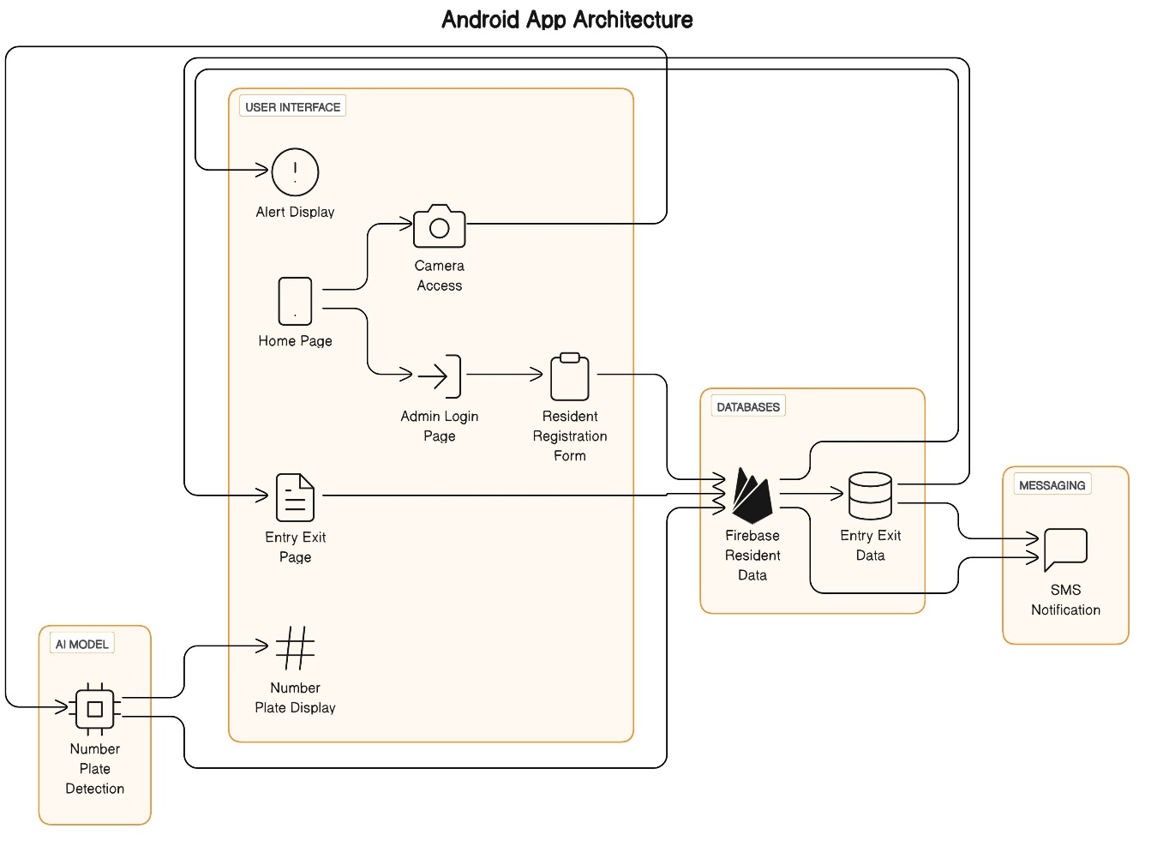
System Design & Implementation

Slide 11
The system architecture comprises several key components:
1. User Interface and Functions:
- Alert Display informs users of unregistered number plates.
- Home Page serves as the primary interaction hub, offering scanning and admin login.
- Admin Login grants access to admin-specific functionalities and Resident Registration Form.
- Resident Registration Form expands the resident database linked to Firebase for storage.
- Camera Access enables number plate detection linked to AI model and Firebase data retrieval.
- Entry Exit Page tracks vehicle movements, connected to the Entry Exit Data database.
2. AI Model:
- Number Plate component detects and recognizes number plates for resident verification or entry/exit recording.
- Detection displays recognized number plates, bridging the gap between AI model and user interface.

Slide 12
3. Databases:
- Firebase Resident Data stores resident information, facilitating efficient retrieval and storage.
- Entry Exit Data maintains accurate vehicle movement records for effective management.
4. Messaging:
- SMS Notification sends alerts to residents regarding their vehicle movements, enhancing communication and keeping residents informed.
The architecture is designed to efficiently manage resident activities and vehicle movements within the residency, prioritizing security and effective monitoring through a comprehensive and interconnected system.

Slide 13
Timeline of Project
Initial Phase
Title Finalization
Literature Survey
Finalizing Objectives
Deciding the Methodology
Existing Methods and Drawbacks
Proposed Methods
Hardware and Software Details
References
Design Phase
Architecture Diagram
Modules
Algorithm Details
Source Code Details
50% implementation

Slide 14
Development Phase
Algorithm Details
Source Code Details
100% implementation details
Live Demonstration of the project
Final Phase
Finalizing the application design
Present 100% implementation details
Submit 100% of the completed report as a hard copy and soft copy.
Live Demonstration of the project
Submit a plagiarism report of the project report.

Slide 15
Outcomes / Results Obtained
Implementing an Automated Vehicle Entry and Exit Management system in a residential community offers various advantageous outcomes for both residents and property management:
1. Enhanced Security:
- Mitigated unauthorized access and meticulous access logs improve overall security, aiding investigations.
2. Improved Safety Measures:
- Managed traffic flow reduces accident risks, and some systems enforce speed limits, enhancing community safety.
3. Efficient Visitor Management:
- Pre-registered guest access and smoother entry processes minimize visitor inconvenience.

Slide 16
4. Efficient Service Delivery:
- Service providers gain streamlined access, reducing service delays, while time-stamped records aid appointment tracking.
5. Cost Savings:
- Decreased reliance on manual personnel leads to potential cost savings, and modern systems typically require less maintenance.
6. Privacy and Accountability Assurance:
- Secure data handling ensures compliance with privacy regulations, fostering accountability among residents and service providers.
7. Enhanced Resident Satisfaction:
- Improved security and convenience contribute to a more satisfactory living experience for residents.

Slide 17
Conclusion
In conclusion, the implementation of an Automated Vehicle Entry and Exit Management system in a residential community is a significant step toward enhancing security, convenience, and efficiency for both residents and property management. This project offers a range of valuable outcomes, including improved security, streamlined access, enhanced safety, and cost savings. By embracing technology-driven solutions, residential communities can create a more welcoming and secure living environment while also optimizing operational processes. The success of such a project relies on thorough planning, proper technology selection, and ongoing maintenance to ensure the system's reliability. Additionally, clear communication with residents, training, and the establishment of access policies are crucial for a smooth transition to the new system. As technology continues to evolve, residential communities should also stay up to date with advancements in access management systems to adapt and further improve their living environments. Ultimately, the Automated Vehicle Entry and Exit Management system project not only contributes to the security and convenience of the community but also enhances the overall quality of life for residents.

Slide 18
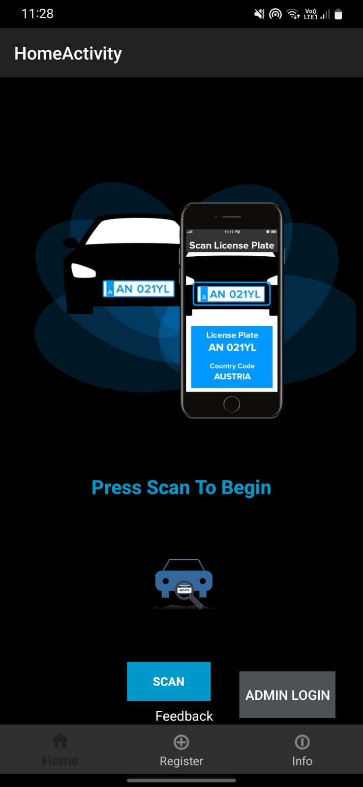
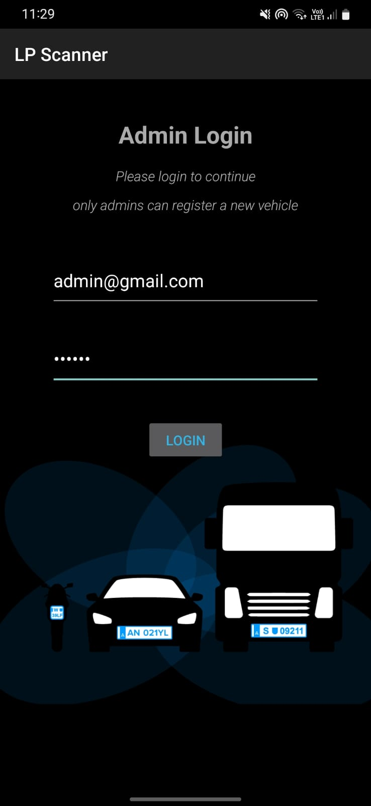
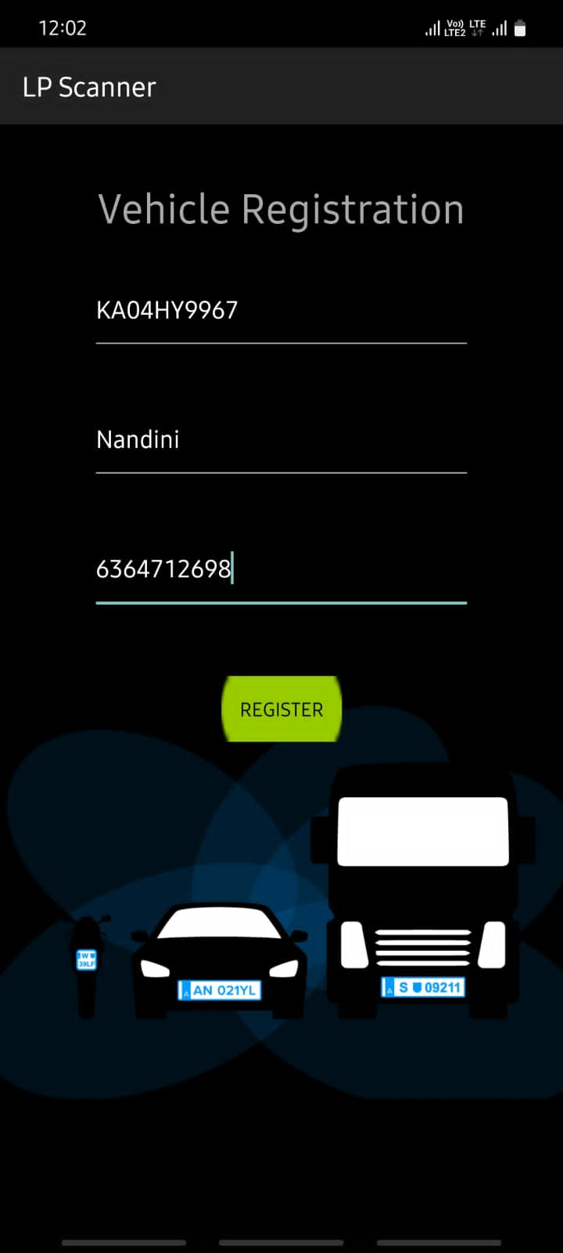
Output
Home Page
Admin Login Page
Vehicle Registration Page

Slide 19
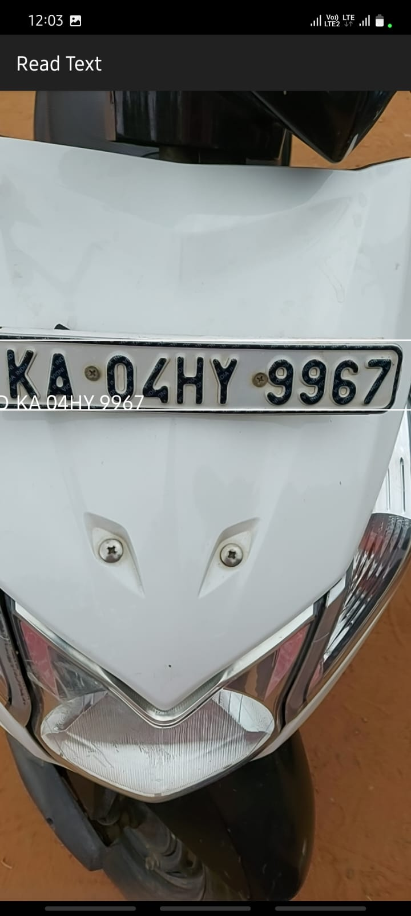
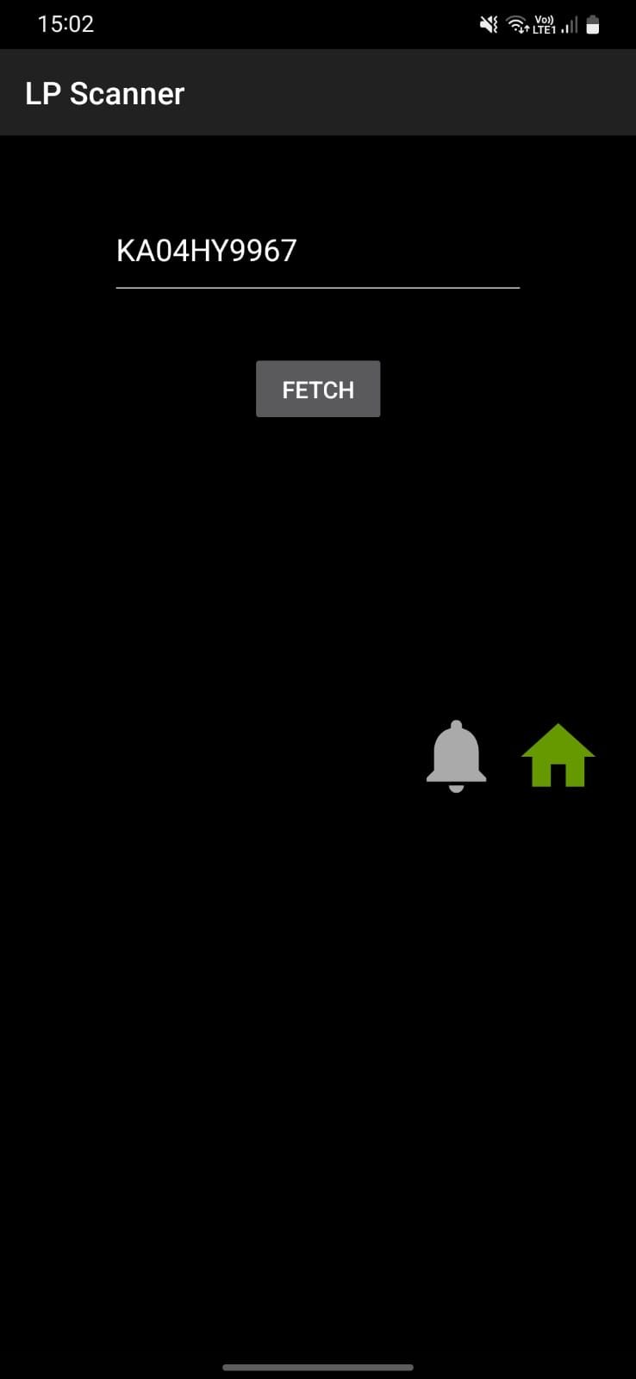
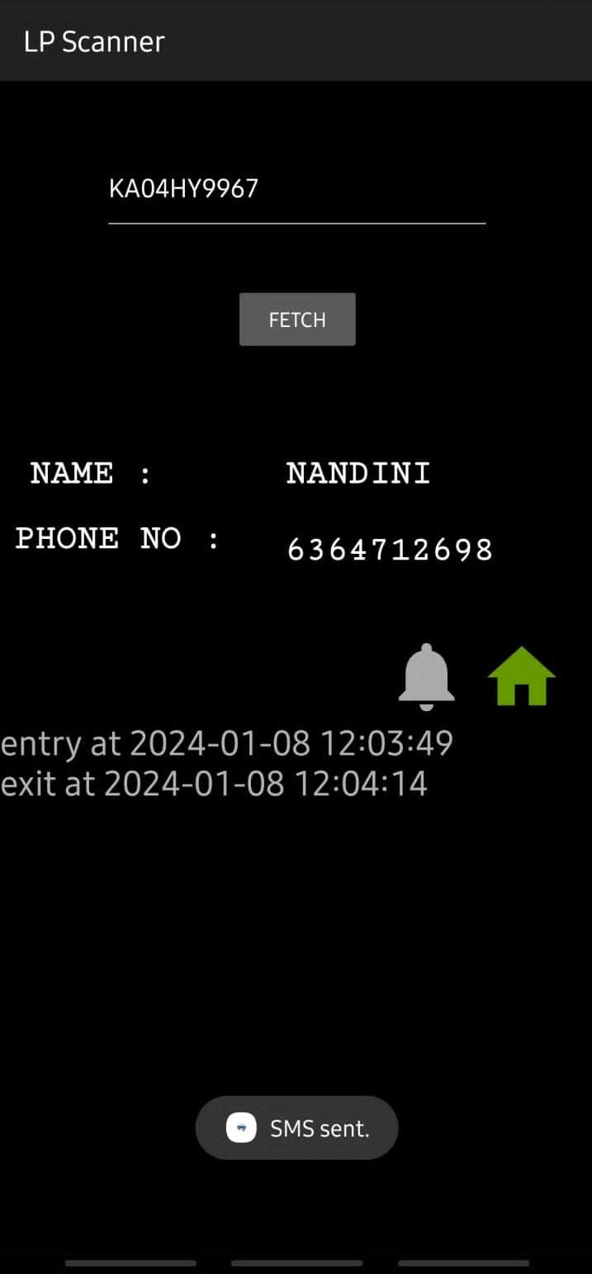
Output
Scanning of Number Plate
Fetching data from database
Entry and Exit Log

Slide 20
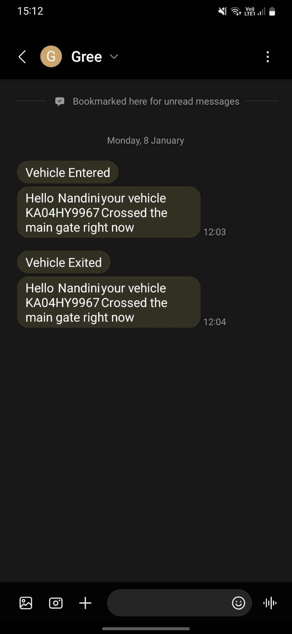
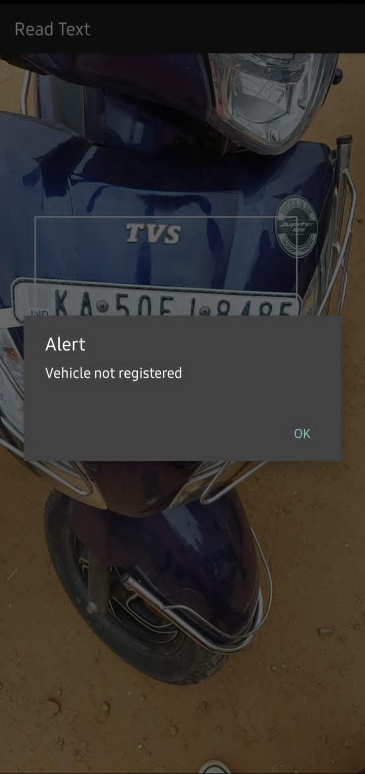
Output
SMS Notification
Alert message for unregistered vehicle

Slide 21
References
N. Darapaneni et al., "Computer Vision based License Plate Detection for Automated Vehicle Parking Management System," 2020 11th IEEE Annual Ubiquitous Computing, Electronics & Mobile Communication Conference (UEMCON), New York, NY, USA, 2020, pp. 0800-0805, doi: 10.1109/UEMCON51285.2020.9298091.
C. -H. Chuang, L. -W. Tsai, M. -S. Deng, J. -W. Hsieh and K. -C. Fan, "Vehicle licence plate recognition using super-resolution technique," 2014 11th IEEE International Conference on Advanced Video and Signal Based Surveillance (AVSS), Seoul, Korea (South), 2014, pp. 411-416, doi: 10.1109/AVSS.2014.6918703.
P. Kulkarni, A. Khatri, P. Banga and K. Shah, "Automatic Number Plate Recognition (ANPR) system for Indian conditions," 2009 19th International Conference Radioelektronika, Bratislava, Slovakia, 2009, pp. 111-114, doi: 10.1109/RADIOELEK.2009.5158763.

Slide 22
K. Yogheedha, A. S. A. Nasir, H. Jaafar and S. M. Mamduh, "Automatic Vehicle License Plate Recognition System Based on Image Processing and Template Matching Approach," 2018 International Conference on Computational Approach in Smart Systems Design and Applications (ICASSDA), Kuching, Malaysia, 2018, pp. 1-8, doi: 10.1109/ICASSDA.2018.8477639.
Y. Lyu, J. Gui, M. Wan and W. G. J. Halfond, "An Empirical Study of Local Database Usage in Android Applications," 2017 IEEE International Conference on Software Maintenance and Evolution (ICSME), Shanghai, China, 2017, pp. 444-455, doi: 10.1109/ICSME.2017.75.
A. Mojžišová and M. Mojžiš, "Unified platform for the delivery of notifications to smartphones notification," Proceedings of the 13th International Carpathian Control Conference (ICCC), High Tatras, Slovakia, 2012, pp. 490-494, doi: 1109/CarpathianCC.2012.6228693.

Slide 23
G. G. Desai and P. P. Bartakke, "Real-Time Implementation of Indian License Plate Recognition System," 2018 IEEE Punecon, Pune, India, 2018, pp. 1-5, doi: 10.1109/PUNECON.2018.8745419.
Khawas, Chunnu & Shah, Pritam. (2018). Application of Firebase in Android App Development-A Study. International Journal of Computer Applications. 179. 49-53. 10.5120/ijca2018917200.
N. P. Ap, T. Vigneshwaran, M. S. Arappradhan and R. Madhanraj, "Automatic Number Plate Detection in Vehicles using Faster R-CNN," 2020 International Conference on System, Computation, Automation and Networking (ICSCAN), Pondicherry, India, 2020, pp. 1-6, doi: 10.1109/ICSCAN49426.2020.9262400.

Slide 24
Publication Details
Paper Title - Automated Vehicle Entry and Exit Management for Residency
Published site - https://www.ijircce.com/
Date of Issue – 12 / 01 / 2024

Slide 25

Thank You

